Slide 1
Power Data Time Series Analysis
By: Shubham Agarwal, Taronish Gotlaseth, Jackson Bronkema,
Jonathan Mathai, and Prabhuram Popuri

Slide 2
Agenda
Business Problem
Data
Relationship Between Power Usage and Cloud Cover
Model Building and Forecasting
Takeaways and Conclusion

Slide 3

Business Problem
Duke Energy is a major power distribution company. As consultants for Duke, we have kept track of the last 43 weeks of local weather and power usage data. Our goal is to use these statistics to forecast the future demand of the consumers.
We are leveraging the cloud cover data for forecasting the future demand.
Notes:
Weather screenshot under statement.

Slide 4
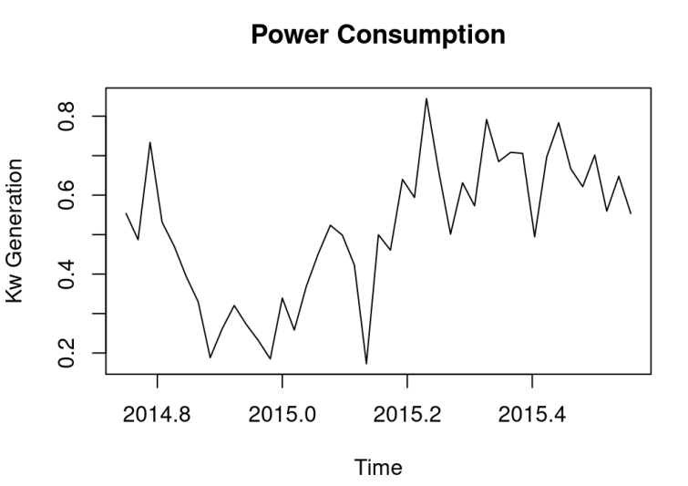
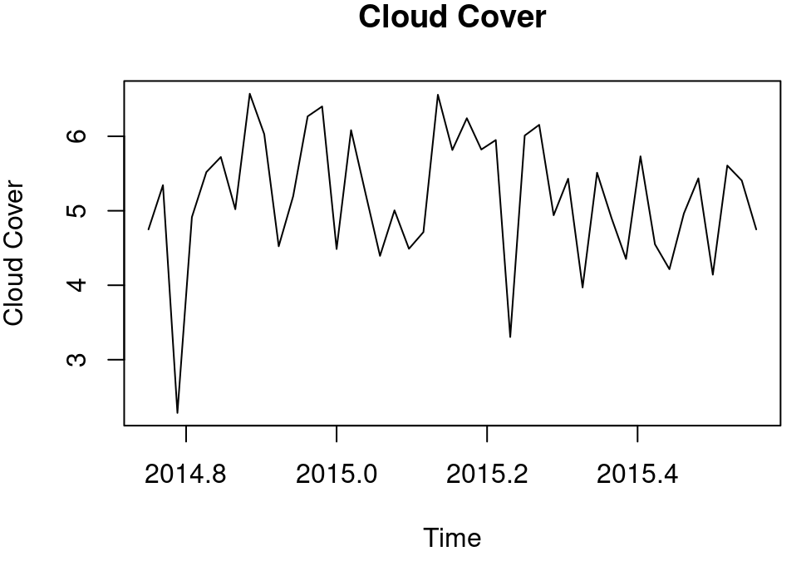
Data
We have weekly power consumption and cloud cover data for almost 1 year (43 weeks).
Hypothesis – Power consumption high when cloud cover is low and vice versa.

Slide 5
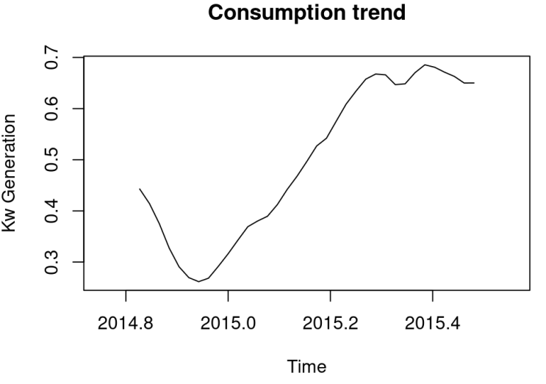
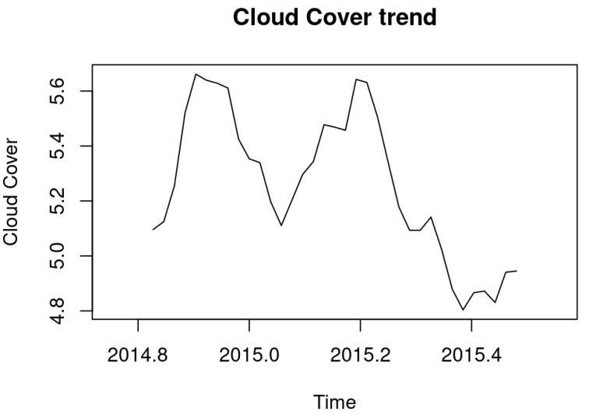
Time Series Analysis
The data provided is less than 52 weeks, hence we cannot tell whether the time series has seasonality
We cannot say that Cloud cover data has a significant trend, but the Consumption data has a significant trend

Slide 6
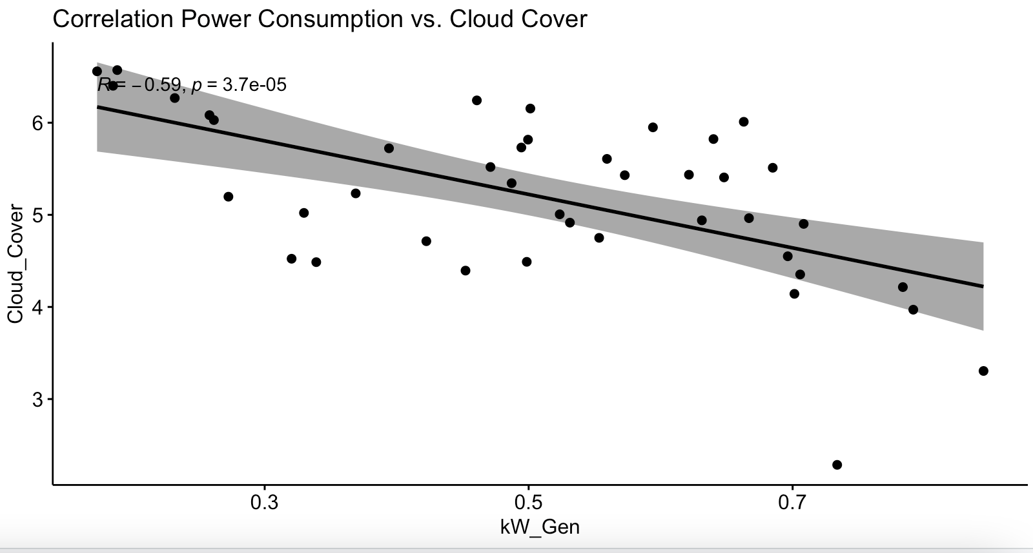
Power consumption is correlated with cloud cover
There is a - 0.59 correlation between cloud cover and power consumption
This supports our initial hypothesis

Slide 7

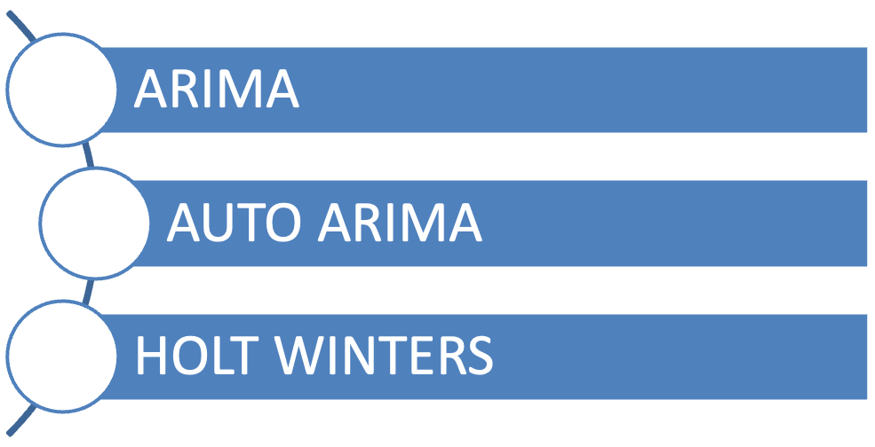
MODELLING
SPLIT THE DATA INTO TRAIN AND VALIDATION (HOLDOUT SET)
USED LAST 8 WEEK DATA FOR VALIDATION

Slide 8

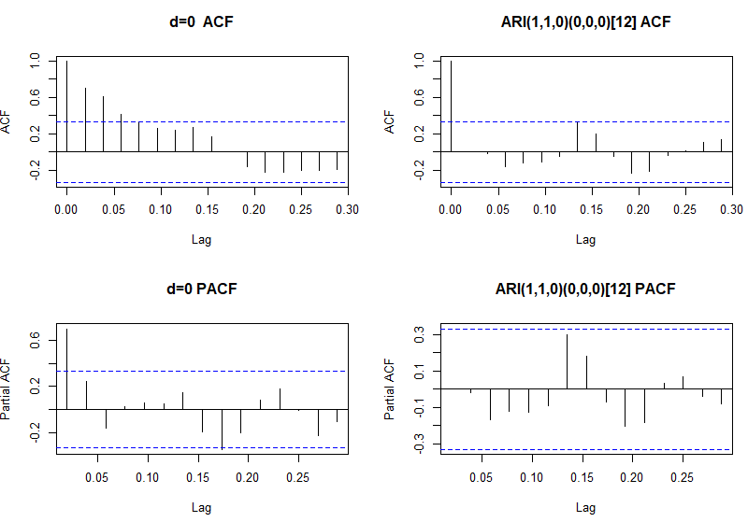
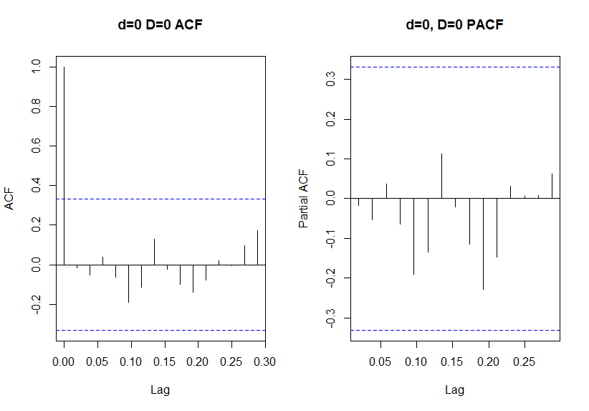
ARIMA
Power Consumption
Cloud cover
Final Model
Final Model
Order = (1,1,0) ; No Seasonality
Order = (0,0,0) ; No Seasonality

Slide 9
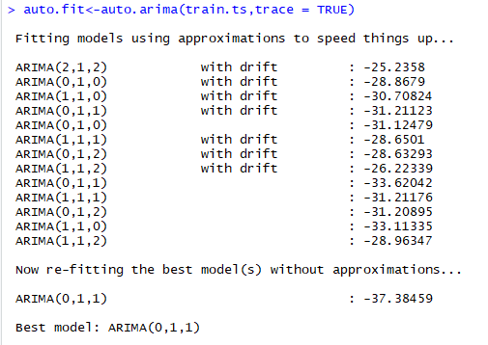
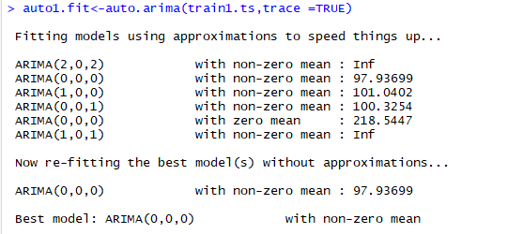
AUTO-ARIMA
Power Consumption
Cloud cover
Final Model
Final Model
Order = (0,1,1) ; No Seasonality
Order = (0,0,0) ; No Seasonality

Slide 10
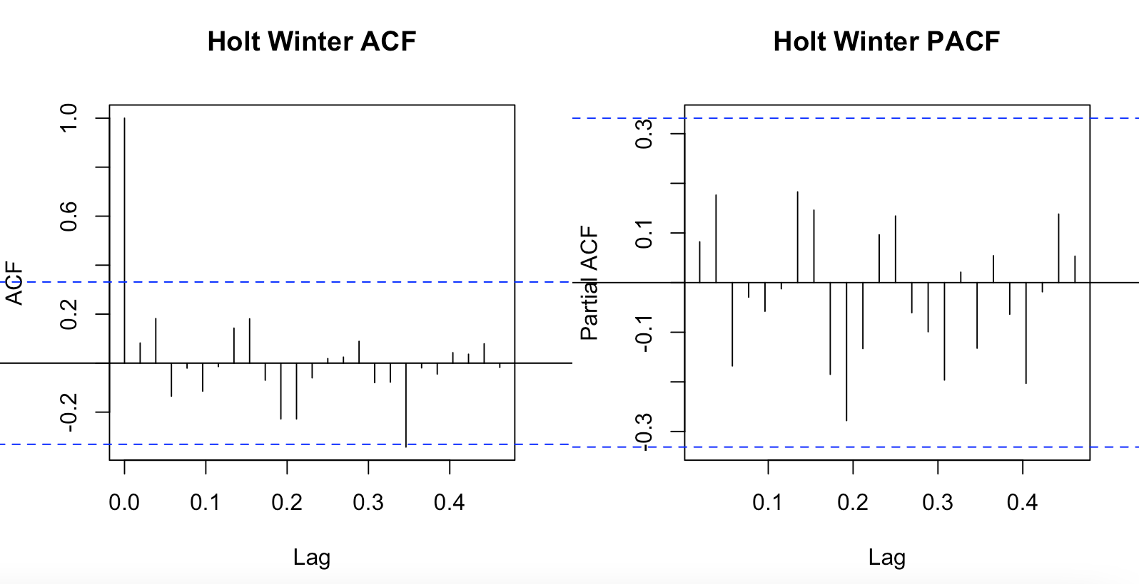
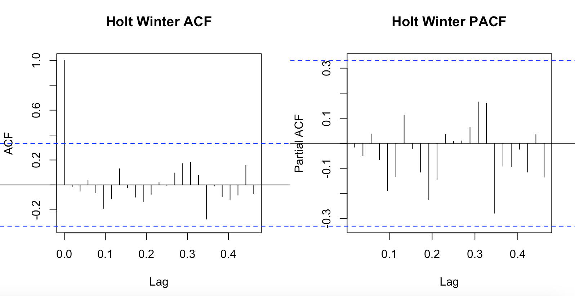
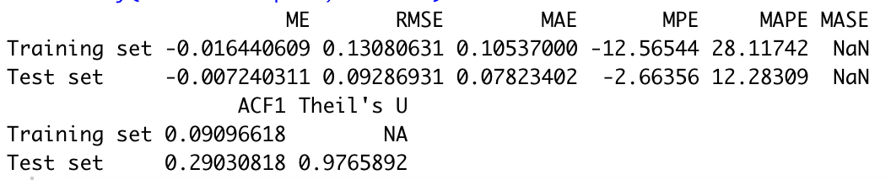
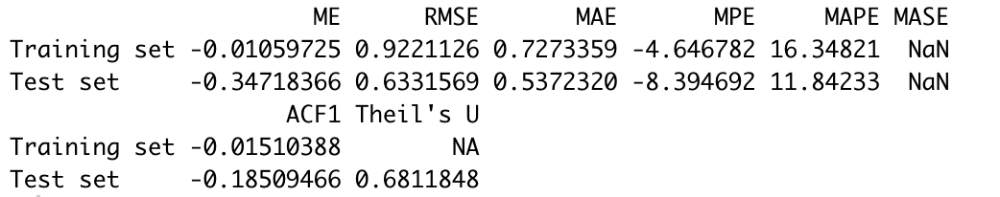
Holt-Winters
Power Consumption
Cloud cover

Slide 11


Forecasting
RMSE results
Model | RMSE (Power Con in Kw) | RMSE(Cloud Cover)
ARIMA | 0.123 | 0.64
Auto ARIMA Holt Winters | 0.106 0.092 | 0.64 0.63
WINNER
Result : Holt Winters has the lowest RMSE on validation data set and hence will be used for prediction on complete data set

Slide 12

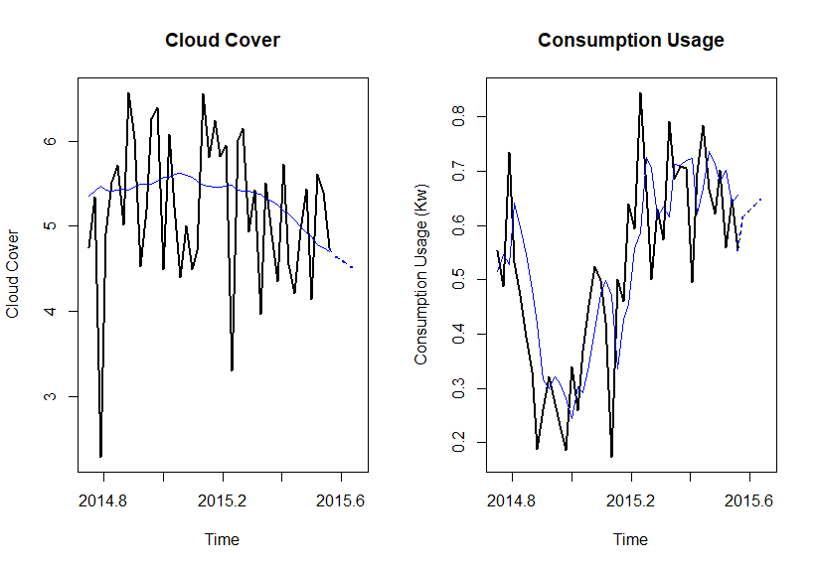
Forecasting with Champion Model
Holt-Winters
In the next 4 weeks we are expecting the decrease in the cloud cover so we are expecting the increase in the power consumption.

Slide 13
Takeaways and Conclusion
For the next 4 weeks, Power consumption will be 2.53 kW and the approximate revenue for Duke Energy per customer will be $215 USD
Limitations
Limited dataset (not getting spring, summer, fall, winter).
Having data for the entire city (MW) which will help in creating more time-series models.

Slide 14
Thank You!!!!

